Slide 1
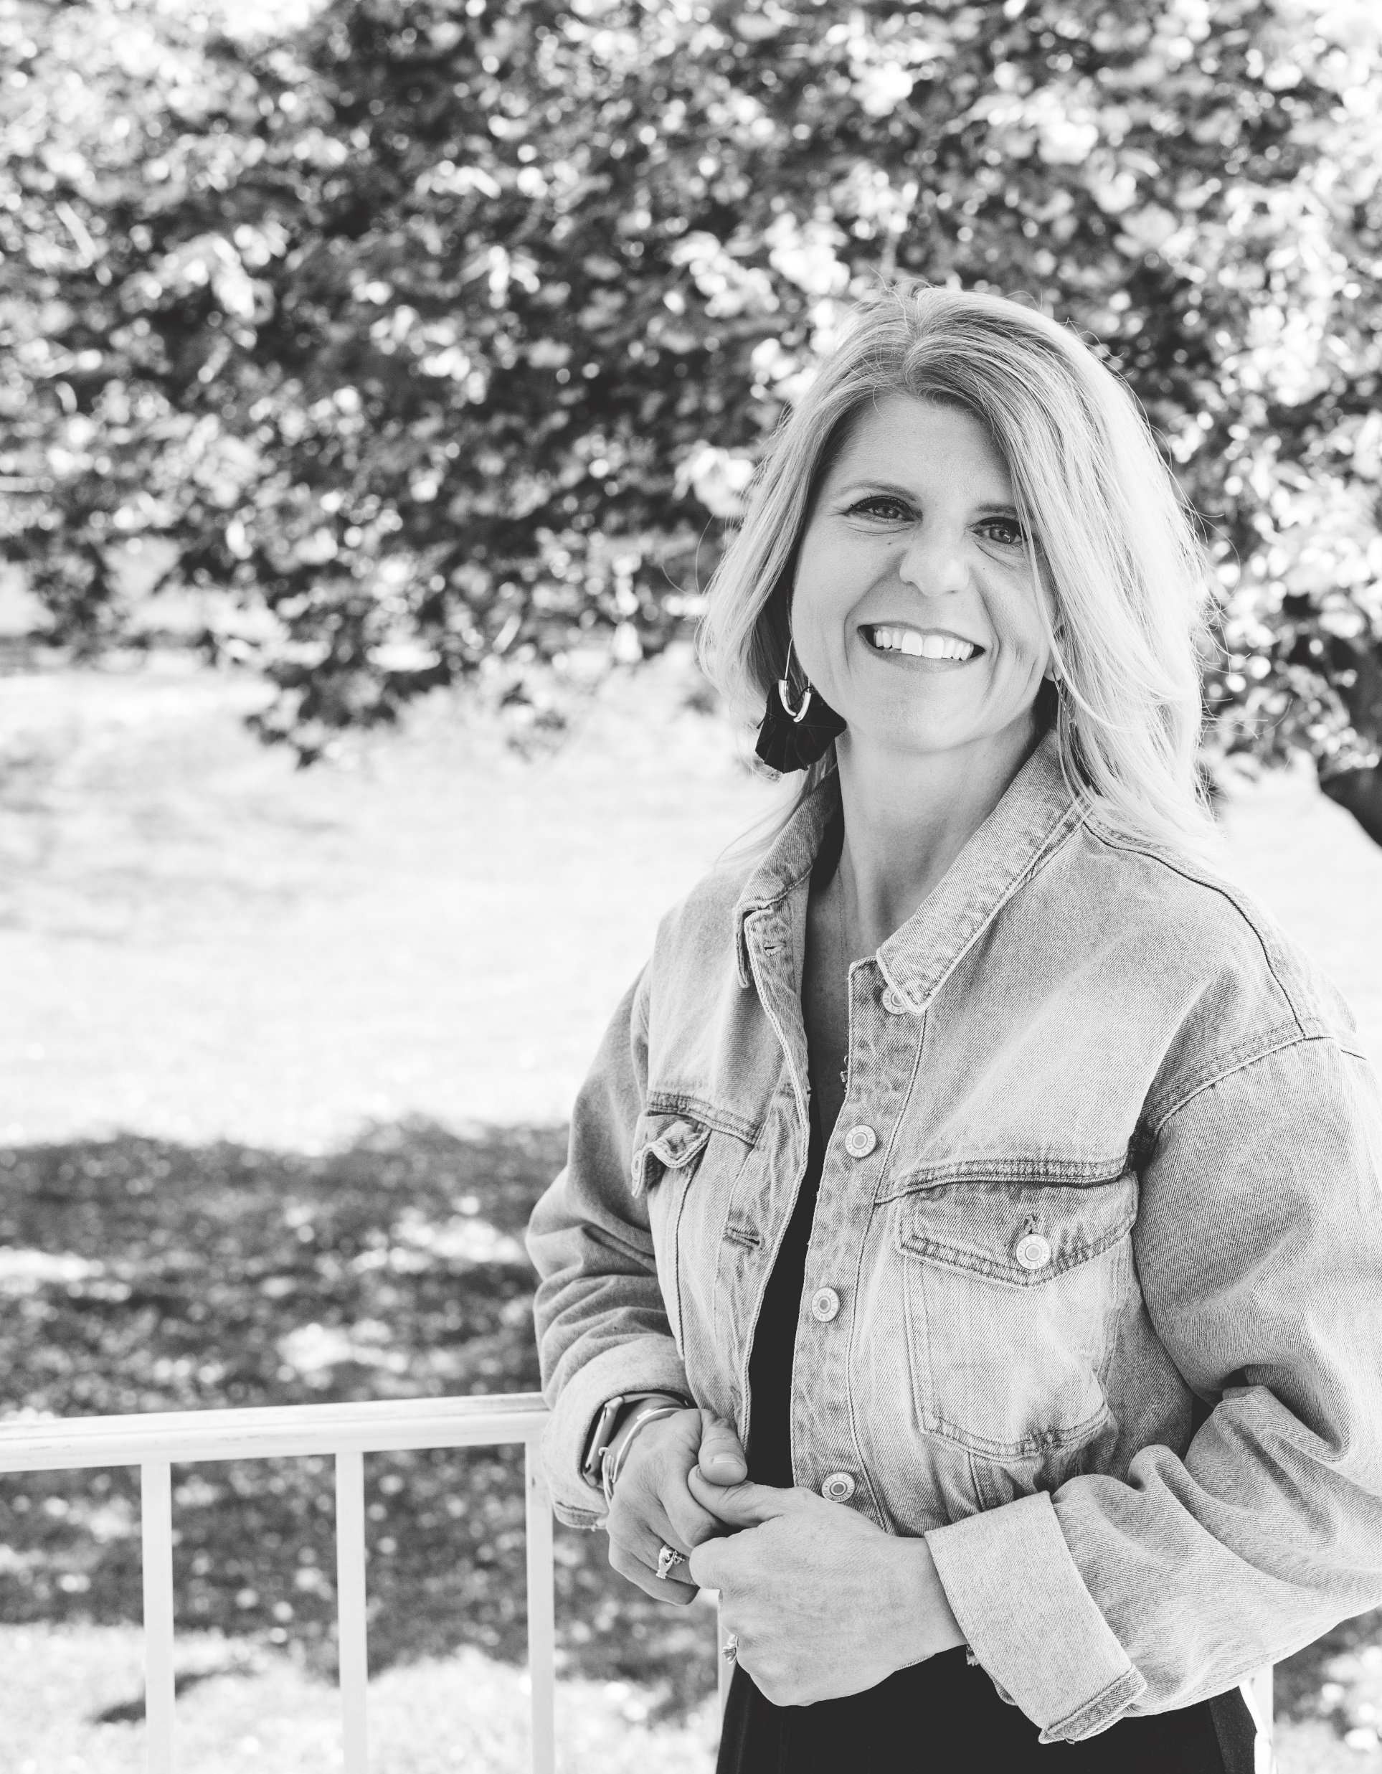





Meredith McNerney
The Calmer Network
Meet Meredith
As a cancer survivor, former principal and leader of The
Calmer Network, Meredith McNerney understands that we
bring our whole self to work. She will ignite a new passion in your
organization by teaching employees and managers how to cultivate
calm through connected relationships. As a doctoral candidate at
Northeastern University, she studies the connection between emotional
wellness and performance outcomes. She is certified in Employee Wellness and Stress Management from Stanford’s Center for Health Education. Meredith lives in Maryland with her husband and two children.
Speaking Topics
Being Trauma-Informed:Build Better Relationships
Many humans show up to work asking, “Am I safe here? Am I valued?” This is because our brains perform optimally if we feel a sense of psychological safety and belonging. When it comes to understanding people, it is important to know what cultivates safety and belonging. Executive leaders have an opportunity to create optimal working conditions but they must first understand the roots of trauma, how trauma can show up at work, and strategies for building trusting and safe relationships at work.
Resilience: How to Stay Calm When Challenges Arise
Our thought patterns can be damaging. Whether we approach stress with a catastrophic mindset or we get stuck in black and white thinking, it is important to understand how our ruminating thoughts continuously release stress chemicals in our body.
Research on thought management reminds us that if we want to remain calm under pressure, we need to understand potentially damaging thought patterns and strategies to overcome them.
Leadership:Balancing Empathy with Accountability to
Maximize Team Performance
What’s on your business card? Most of us think of our business card as a place to share our name, title, and role at work. However, who we are beyond our title has a lot to do with how well we perform at work. In order to maximize performance, we need to understand what is on the “back of the business card” for each of our team members. Understanding “who” someone is rather than what they do produces a culture of trust and accountability.
Meredith Has Worked With
BOOKING AND PRESS INQUIRIES
Press Inquiries press@talentconcierge.co
Speaking Inquiries hello@talentconcierge.co
Talent Concierge® 570.906.4395

